Slide 1
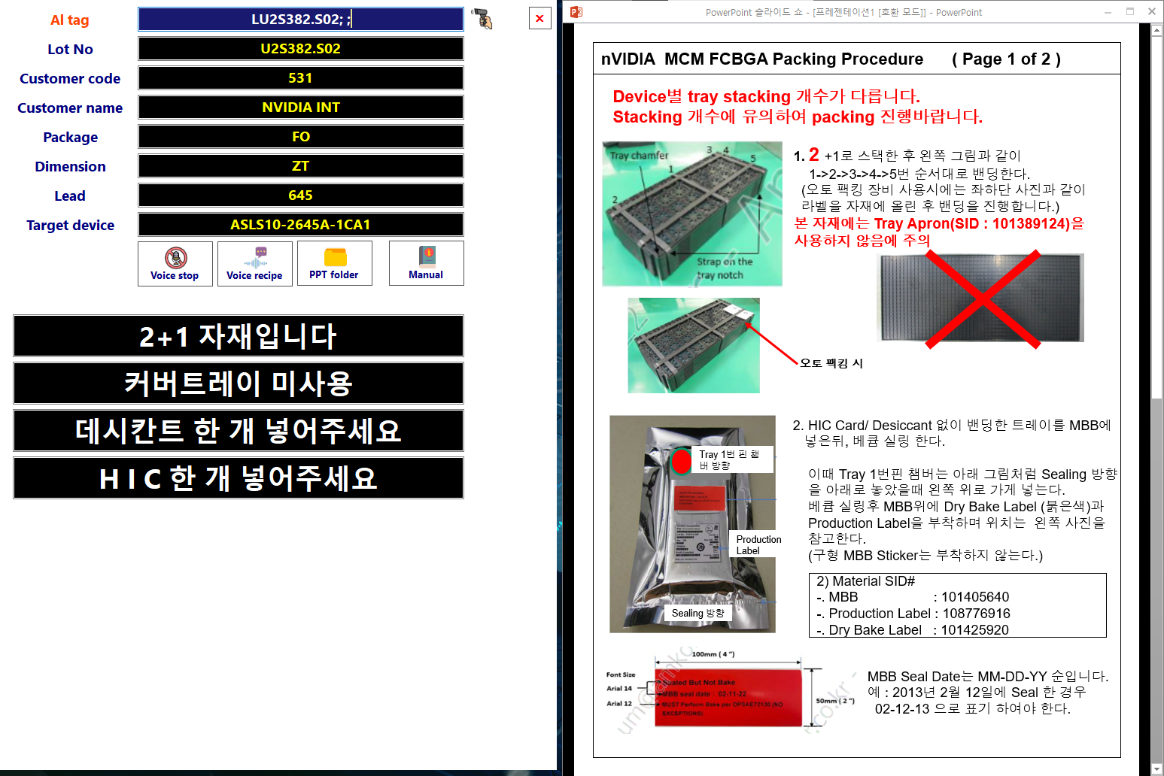
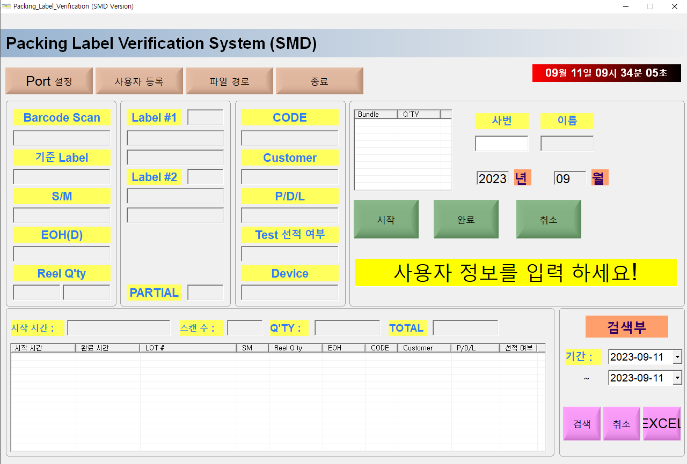
Weekly EED Activity – WW37
K5 / 2T 2P
FCBGA / Packing
New
K5 FCBGA, Packing voice assistant program development
MFG / EED
NA
N/A
[Problem Description]
[Action taken]
Occur potential packing issues
Previous program only show WI screen
WI is too long to figure out main point
Developed voice assistant program
Validate packing label
Display WI load + packing key word
Voice assistant to guide main point
Validation Program
WI load
Voice assistant
Method : Only WI
Method : WI & Voice assistant
Cost save : $5K/1set (Outsourcing $5K/set vs. In-house $0K)
Prevention of quality problems related to packing
HyunSu Park(DaeHee Son) / ww37 `23 K5EE

